Slide 1

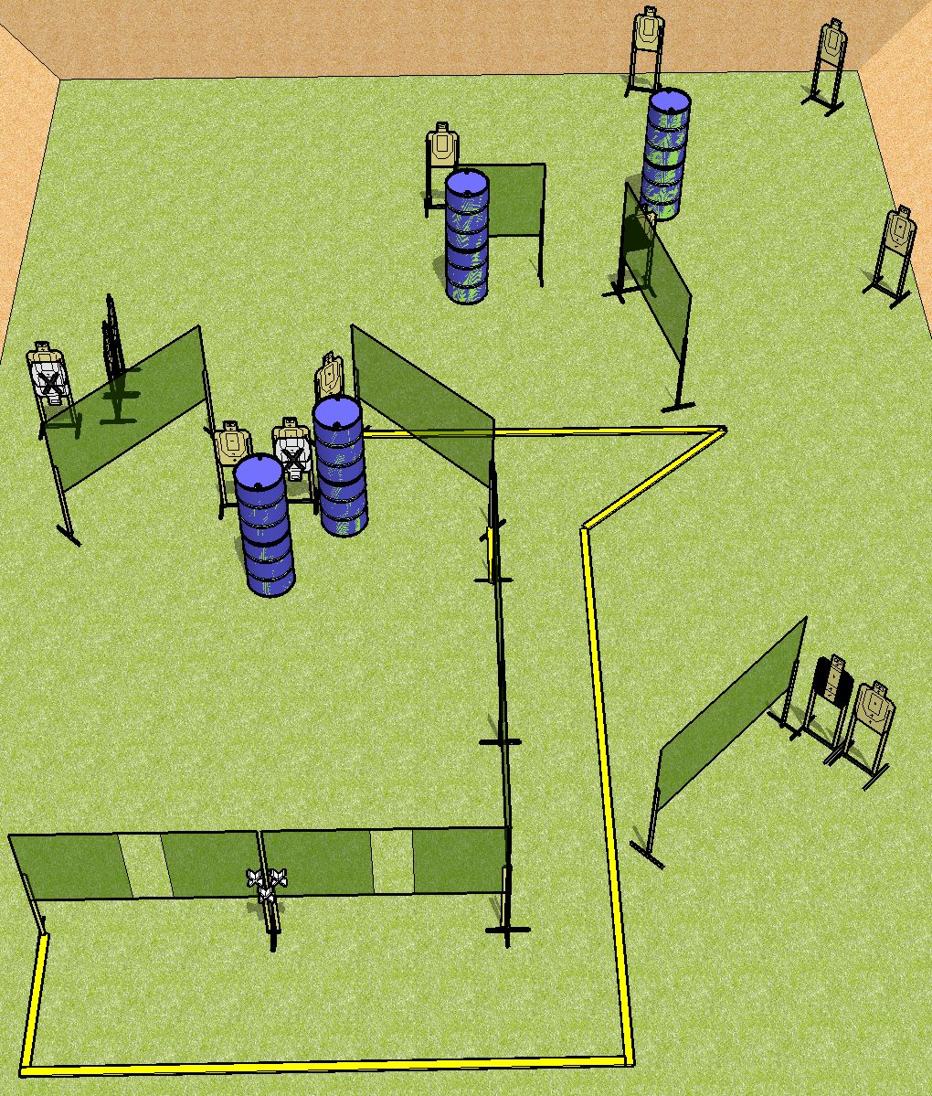
 | Dothan Practical Shooters – USPSA Match Step Course Designer : Drew Coleman Bay: B1
Round Count 26 rounds 13 USPSA
Equipment List 15 wall feet 1 tux, 1 left diag 13 targets (11 + 2 NS)

Slide 2
Step
Written Stage Briefing
Scoring: Comstock Rounds: 26
Targets: 13 USPSA
Handgun start position: hands touching upper set of marks. Handgun is loaded and holstered.
PCC start position: muzzle touching lower mark, stock on belt. Loaded carbine is held with both hands, safety on.
Stage Procedure: on the audible start signal, engage targets as they become available from within the shooting area.

